Slide 1
Who Needs an Encoder?
Evaluating the Use of Random Latent
Representations in Variational Autoencoders
Mick IJzer
Supervisor: Jakub Tomczak

Slide 2
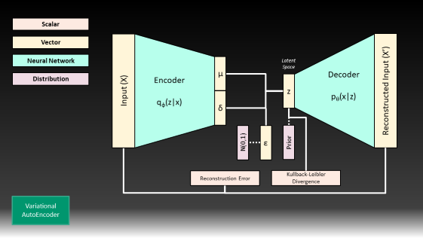
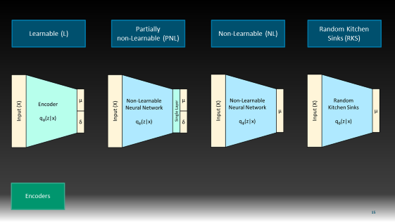
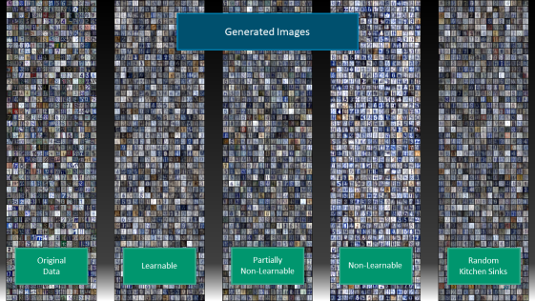
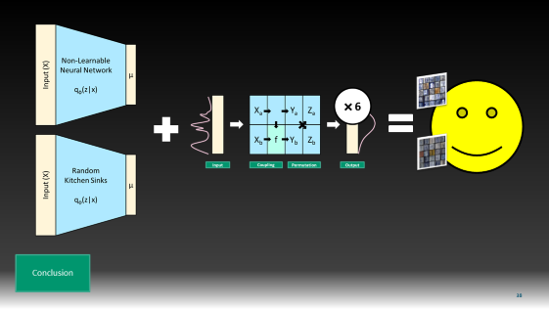
1.
2.
3.
4.
Overview

Slide 3
Introduction

Slide 4
Vector
Input (X)
Neural Network
Encoder
q_{φ}(z|x)
µ
µ
δ
δ²
Variational
AutoEncoder

Slide 5
Vector
Input (X)
Neural Network
Encoder
q_{φ}(z|x)
µ
µ
Latent
Space
Distribution
z
δ
δ²
N(0,1)
ε
Variational
AutoEncoder

Slide 6
Vector
Input (X)
Reconstructed Input (X’)
Neural Network
Encoder
q_{φ}(z|x)
Decoder
p_{θ}(x|z)
µ
µ
Latent
Space
Distribution
z
δ
δ²
N(0,1)
ε
Variational
AutoEncoder

Slide 7
Scalar
Vector
Input (X)
Reconstructed Input (X’)
Neural Network
Encoder
q_{φ}(z|x)
Decoder
p_{θ}(x|z)
µ
µ
Latent
Space
Distribution
z
δ
δ²
N(0,1)
ε
Reconstruction Error
Variational
AutoEncoder

Slide 8
Scalar
Vector
Input (X)
Reconstructed Input (X’)
Neural Network
Encoder
q_{φ}(z|x)
Decoder
p_{θ}(x|z)
µ
µ
Latent
Space
Distribution
z
δ
δ²
N(0,1)
ε
Prior
Reconstruction Error
Regularization Term
Variational
AutoEncoder

Slide 9
Scalar
Vector
Input (X)
Reconstructed Input (X’)
Neural Network
Encoder
q_{φ}(z|x)
Decoder
p_{θ}(x|z)
µ
µ
Latent
Space
Distribution
z
δ
δ²
N(0,1)
ε
Prior
Reconstruction Error
Regularization Term
Variational
AutoEncoder

Slide 10
Scalar
Vector
Input (X)
Reconstructed Input (X’)
Neural Network
Encoder
q_{φ}(z|x)
Decoder
p_{θ}(x|z)
µ
µ
Latent
Space
Distribution
z
δ
δ²
N(0,1)
ε
Prior
Reconstruction Error
Regularization Term
Variational
AutoEncoder

Slide 11
Scalar
Vector
Input (X)
Reconstructed Input (X’)
Neural Network
Encoder
q_{φ}(z|x)
Decoder
p_{θ}(x|z)
Latent
Space
Distribution
z
Reconstruction Error
AutoEncoder

Slide 12
Scalar
Vector
Input (X)
Reconstructed Input (X’)
Neural Network
Encoder
q_{φ}(z|x)
Decoder
p_{θ}(x|z)
Latent
Space
Distribution
z
Ex-Post Density Estimation
Reconstruction Error
Regularized AutoEncoder

Slide 13
Scalar
||z||²₂
||θ||²₂
Vector
Input (X)
Reconstructed Input (X’)
Neural Network
Encoder
q_{φ}(z|x)
Decoder
p_{θ}(x|z)
Distribution
z
Ex-Post Density Estimation
Reconstruction Error
Regularized AutoEncoder

Slide 14
Scalar
||z||²₂
||θ||²₂
Vector
Input (X)
Reconstructed Input (X’)
Neural Network
Encoder
q_{φ}(z|x)
Decoder
p_{θ}(x|z)
Distribution
z
Ex-Post Density Estimation
Reconstruction Error
Regularized AutoEncoder

Slide 15
Scalar
||z||²₂
||θ||²₂
Vector
Input (X)
Reconstructed Input (X’)
Neural Network
Encoder
q_{φ}(z|x)
Decoder
p_{θ}(x|z)
Distribution
z
Ex-Post Density Estimation
Reconstruction Error
Regularized AutoEncoder

Slide 16
Scalar
Vector
Input (X)
Reconstructed Input (X’)
Neural Network
Encoder
q_{φ}(z|x)
Decoder
p_{θ}(x|z)
µ
µ
Latent
Space
Distribution
z
δ
δ²
N(0,1)
ε
Prior
Reconstruction Error
Regularization Term
Variational
AutoEncoder

Slide 17
Methodology & Experimental Setup

Slide 18
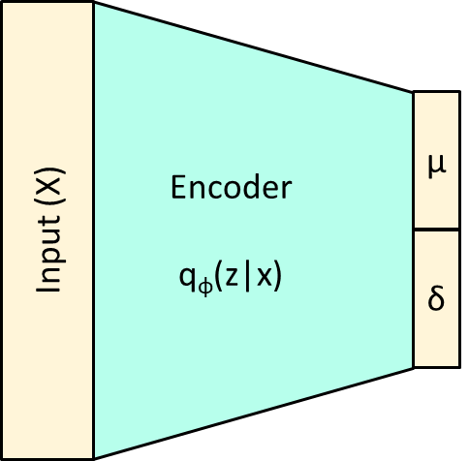
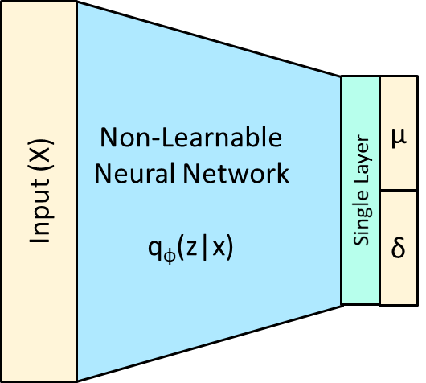
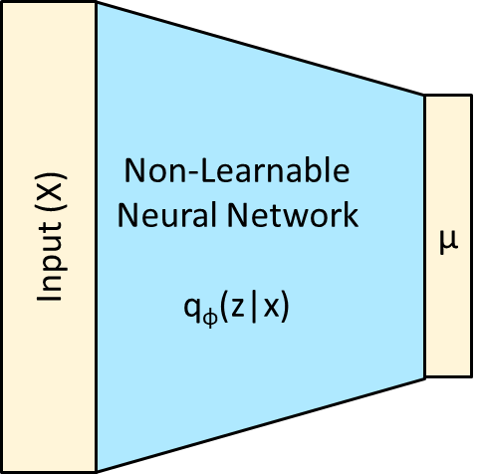
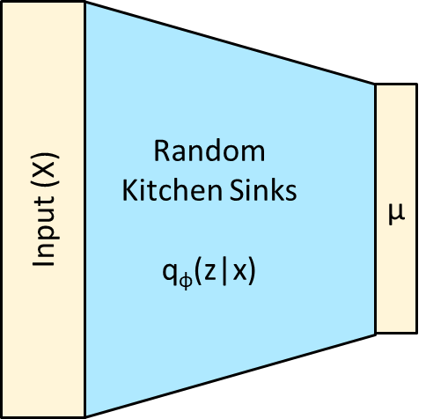
Learnable (L)
Partially
non-Learnable (PNL)
Non-Learnable (NL)
Random Kitchen
Sinks (RKS)
Encoders

Slide 19
Fully Connected Layers
Convolutional Layers
Weight Matrix
Input
Output
Input
Filter
Output
Layer-Types

Slide 20
Standard Normal Prior
Flow-Based Prior (RealNVP)
X_{a}
Y_{a}
Z_{a}
δ = 1
X_{b}
f
Y_{b}
Z_{b}
Input
Coupling
Permutation
Output
μ = 0
Priors

Slide 21
Standard Normal Prior
Flow-Based Prior (RealNVP)
X_{a}
Y_{a}
Z_{a}
δ = 1
X_{b}
f
Y_{b}
Z_{b}
No Trainable Parameters!
Input
Coupling
Permutation
Output
μ = 0
Contains Trainable
Neural Networks!
Priors

Slide 22
Standard Normal Prior
Flow-Based Prior (RealNVP)
2
X_{a}
Y_{a}
Z_{a}
X_{b}
f
Y_{b}
Z_{b}
δ = 1
Input
Coupling
Permutation
Output
6
X_{a}
Y_{a}
Z_{a}
μ = 0
X_{b}
f
Y_{b}
Z_{b}
Priors
Input
Coupling
Permutation
Output

Slide 23
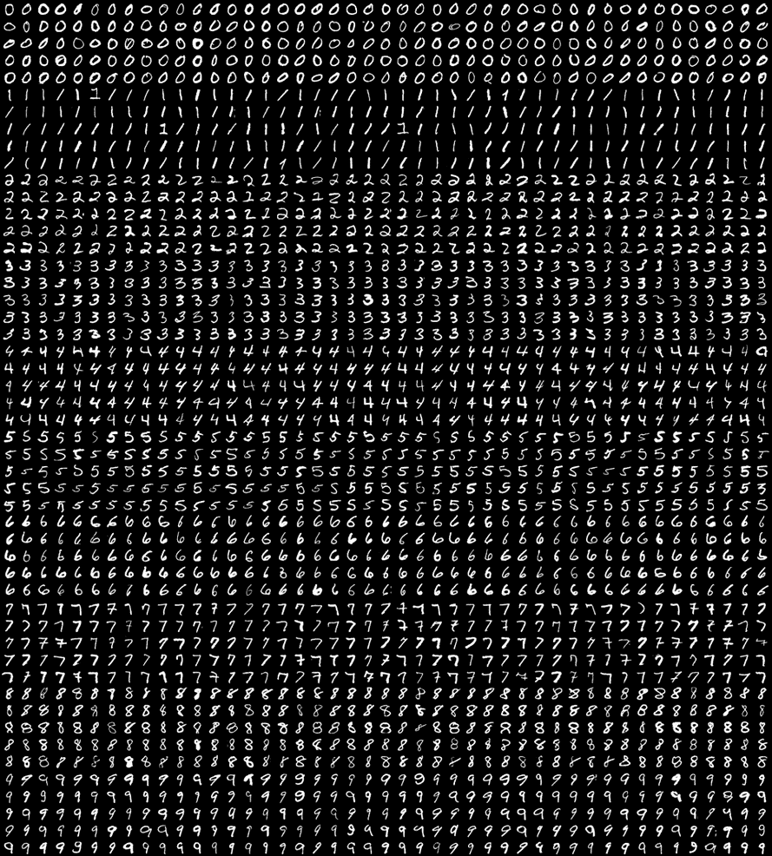

MNIST
SVHN

Slide 24
Model Complexity
(Number of Trainable Weights)
Computation Speed
(Computation Time per Epoch)
Reconstructions
(Reconstruction Error)
Generated Images
(Regularization Term & FID-Score)
Interpolations
(Smoothness of the Latent Space)
Evaluation Metrics

Slide 25
Model Complexity
(Number of Trainable Weights)
Computation Speed
(Computation Time per Epoch)
Reconstructions
(Reconstruction Error)
Generated Images
(Regularization Term & FID-Score)
Interpolations
(Smoothness of the Latent Space)
Evaluation Metrics

Slide 26
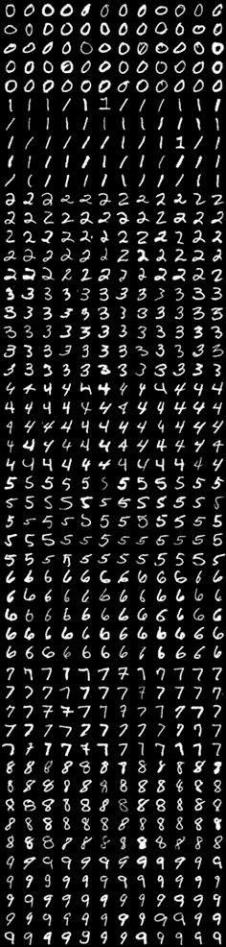
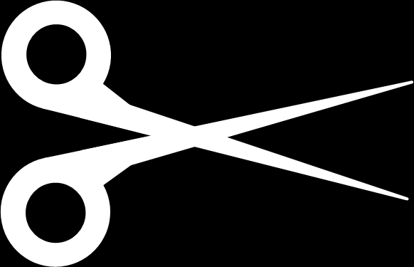
α = …
p = …
F = …
t = …
df = …
Train
5
Validation
Approach
Test

Slide 27
Results

Slide 28
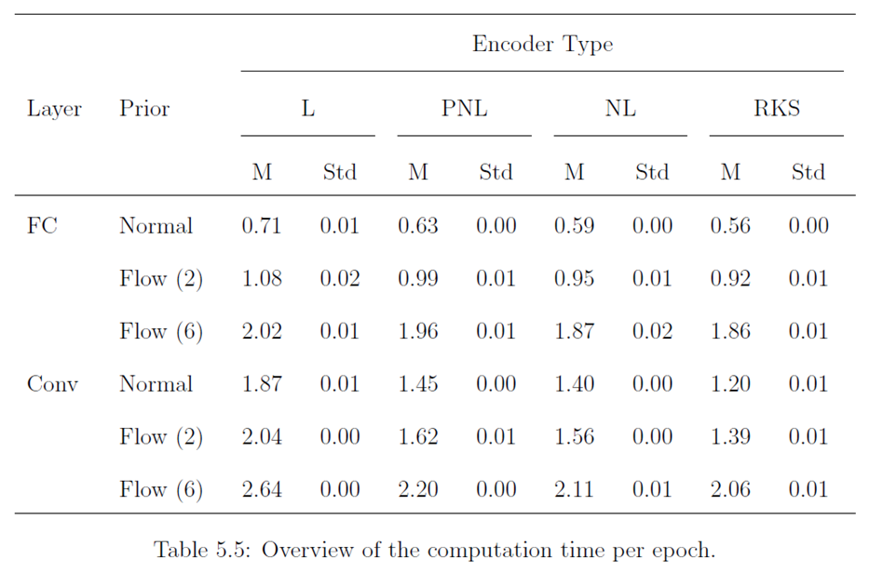
L = Learnable
PNL = Partially
Non-Learnable
NL = Non-Learnable
RKS = Random Kitchen
Sinks
Results:
MNIST

Slide 29
L = Learnable
PNL = Partially
Non-Learnable
NL = Non-Learnable
RKS = Random Kitchen
Sinks
Results:
MNIST

Slide 30
L = Learnable
PNL = Partially
Non-Learnable
NL = Non-Learnable
RKS = Random Kitchen
Sinks
Results:
MNIST

Slide 31
L = Learnable
PNL = Partially
Non-Learnable
NL = Non-Learnable
RKS = Random Kitchen
Sinks
Results:
MNIST

Slide 32
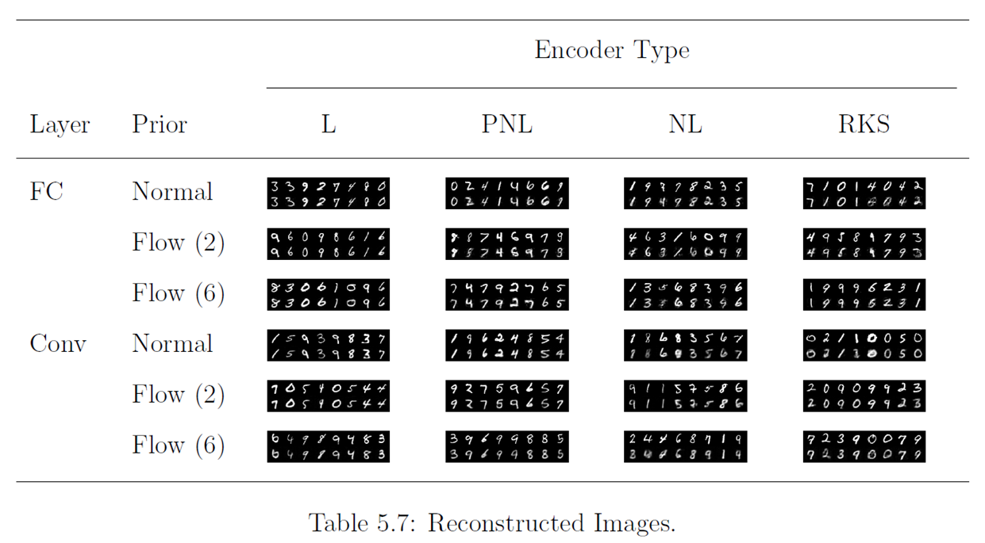
L = Learnable
PNL = Partially
Non-Learnable
NL = Non-Learnable
RKS = Random Kitchen
Sinks
Results:
MNIST

Slide 33
L = Learnable
PNL = Partially
Non-Learnable
NL = Non-Learnable
RKS = Random Kitchen
Sinks
Results:
MNIST

Slide 34
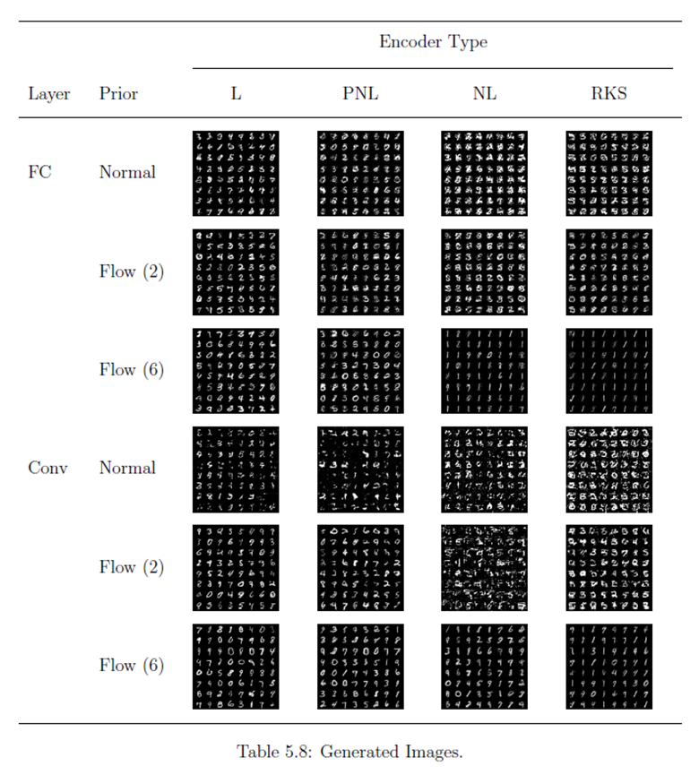
L = Learnable
PNL = Partially
Non-Learnable
NL = Non-Learnable
RKS = Random Kitchen
Sinks
Results:
MNIST

Slide 35
L = Learnable
PNL = Partially
Non-Learnable
NL = Non-Learnable
RKS = Random Kitchen
Sinks
Results:
MNIST

Slide 36
L = Learnable
PNL = Partially
Non-Learnable
NL = Non-Learnable
RKS = Random Kitchen
Sinks
Results:
MNIST

Slide 37
L = Learnable
PNL = Partially
Non-Learnable
NL = Non-Learnable
RKS = Random Kitchen
Sinks
Results:
MNIST

Slide 38
L = Learnable
PNL = Partially
Non-Learnable
NL = Non-Learnable
RKS = Random Kitchen
Sinks
Results:
MNIST

Slide 39
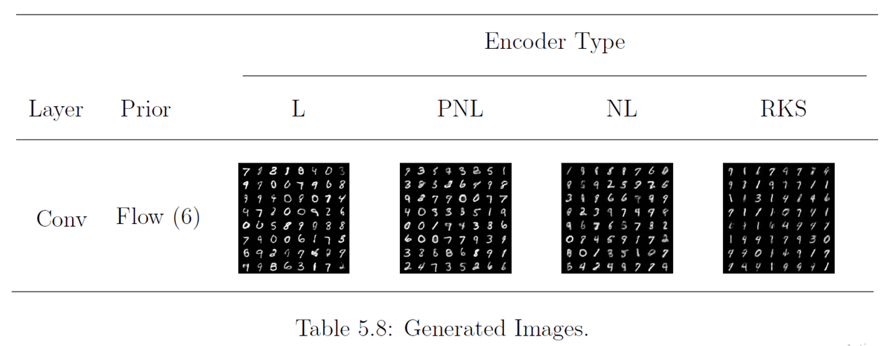
L = Learnable
PNL = Partially
Non-Learnable
NL = Non-Learnable
RKS = Random Kitchen
Sinks
Results:
MNIST

Slide 40
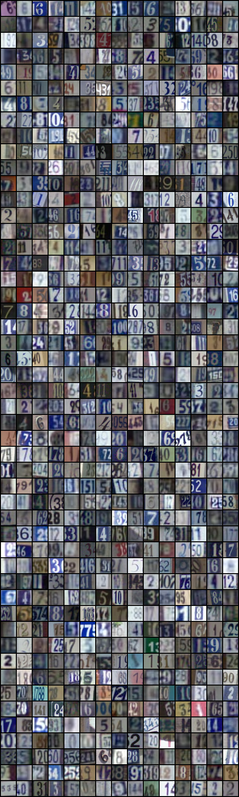
Generated Images
Original
Data

Slide 41
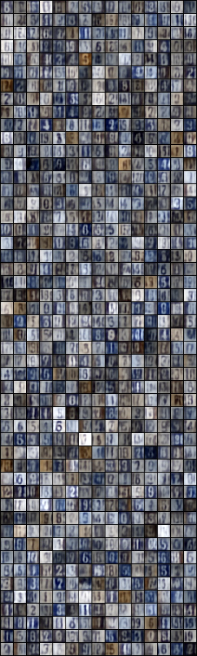
Generated Images
Original
Data
Learnable

Slide 42

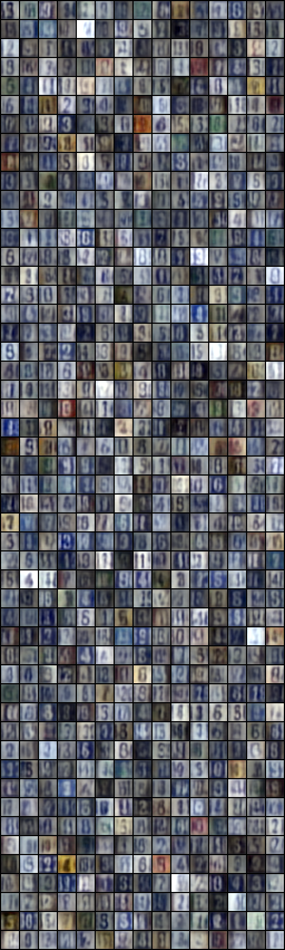
Generated Images
Original
Data
Learnable
Partially
Non-Learnable

Slide 43
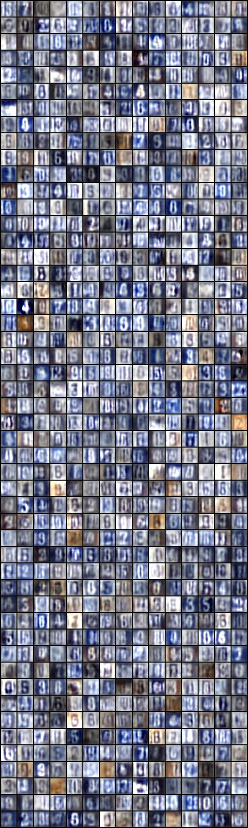
Generated Images
Original
Data
Learnable
Partially
Non-Learnable
Non-Learnable

Slide 44
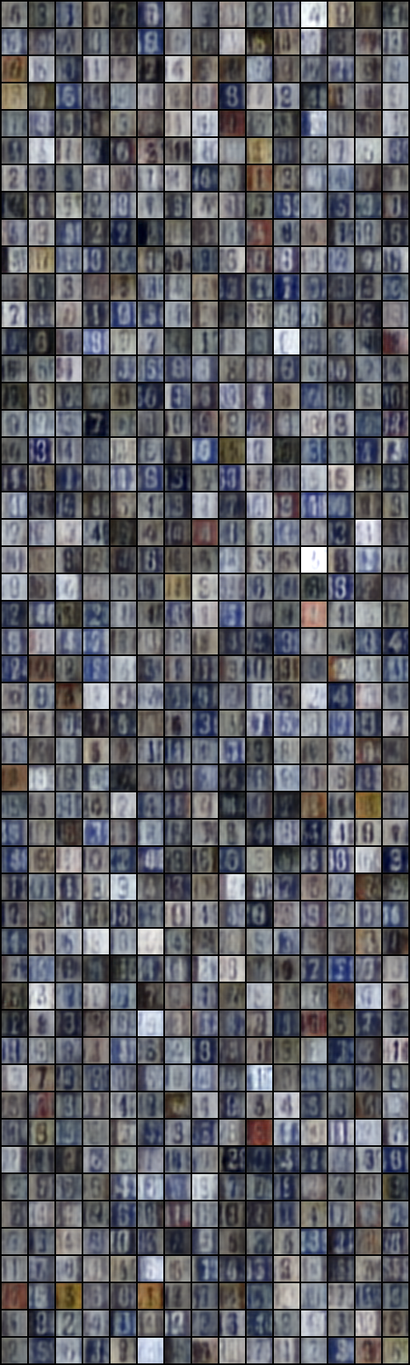
Generated Images
Original
Data
Learnable
Partially
Non-Learnable
Non-Learnable
Random
Kitchen Sinks

Slide 45
Conclusion

Slide 46
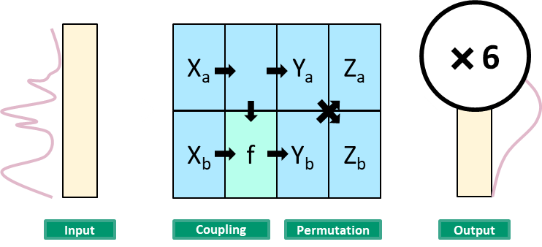
Conclusion

Slide 47
Original
Data
Non-Learnable
Conclusion

Slide 48
Original
Data
Random
Kitchen Sinks
Conclusion

Slide 49


Learnable
Partially
Non-Learnable
Conclusion

Slide 50
State-of-the-Art Performance
Improve Consistency
More Complex Data Sets
More Complex Architectures
Regularized Autoencoder with
(Partially) Non-Learnable Encoder
Priors, Batch
Normalization & Dropout
Future
Research

Slide 51
Questions?

Slide 52
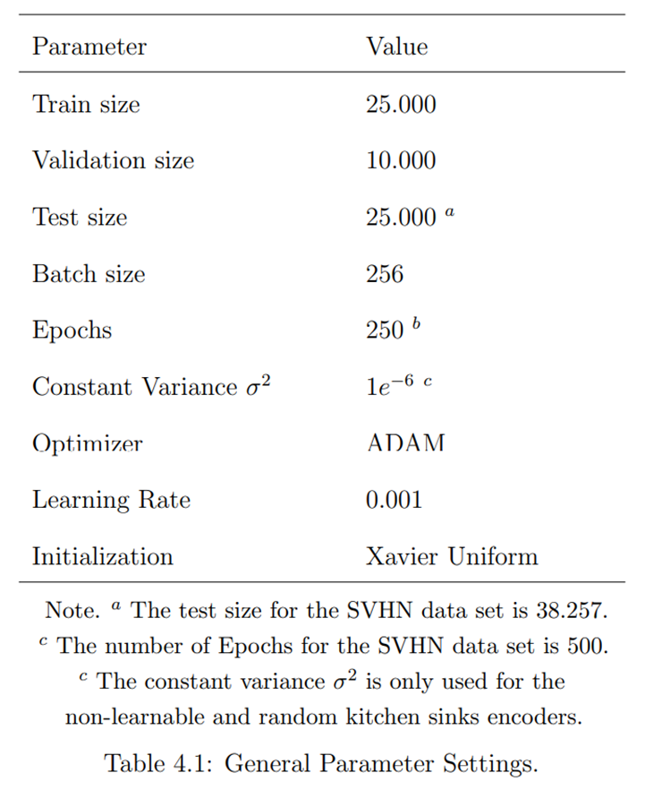

Slide 53
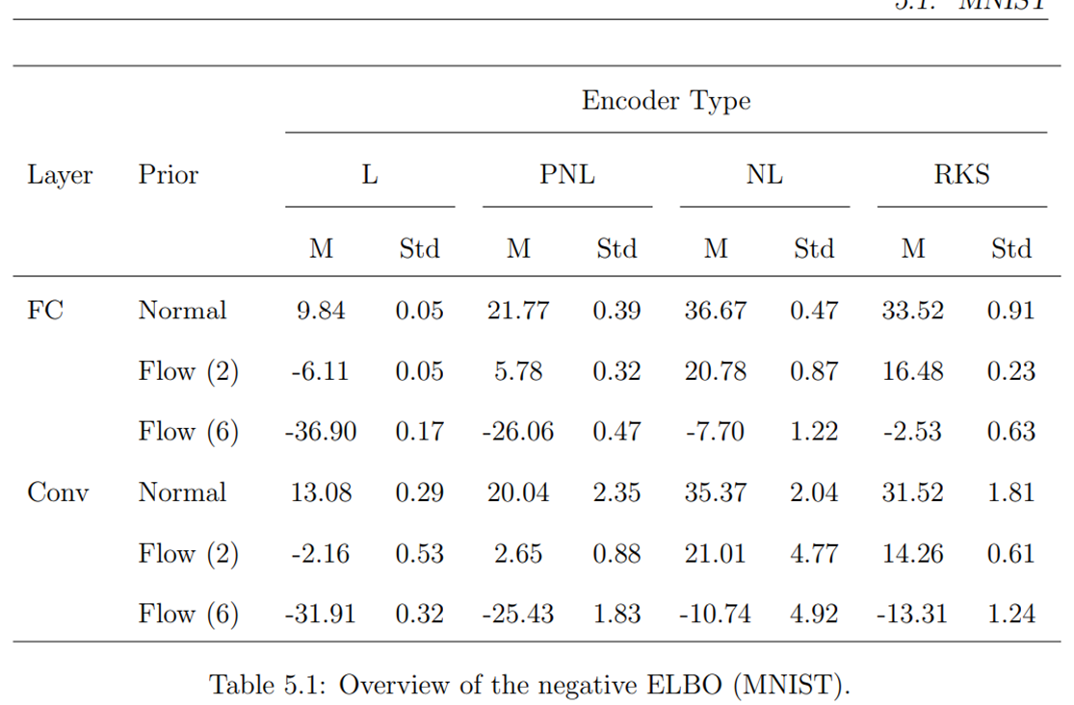

Slide 54
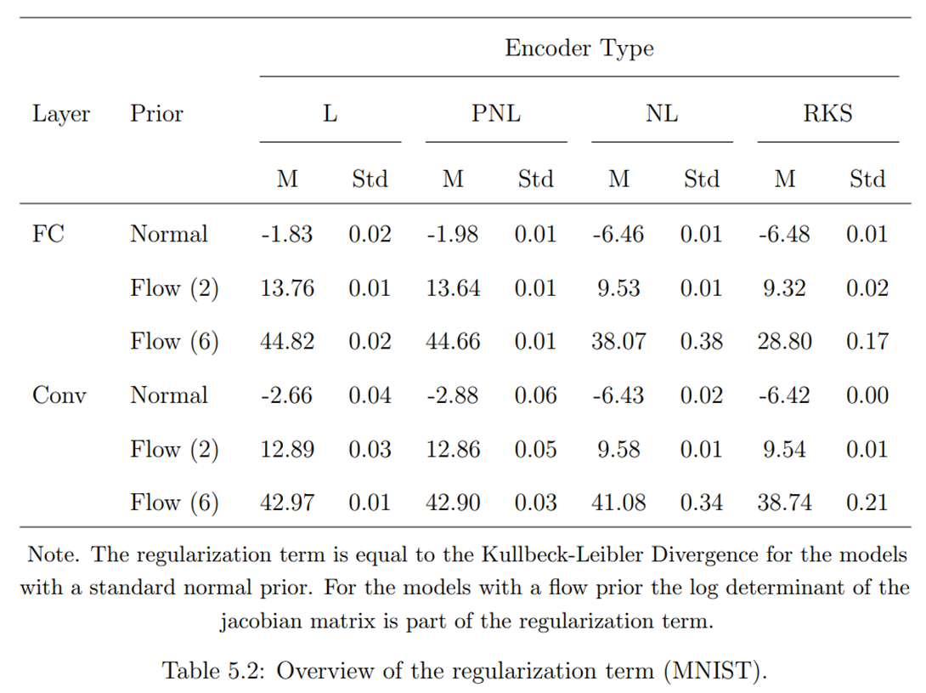

Slide 55
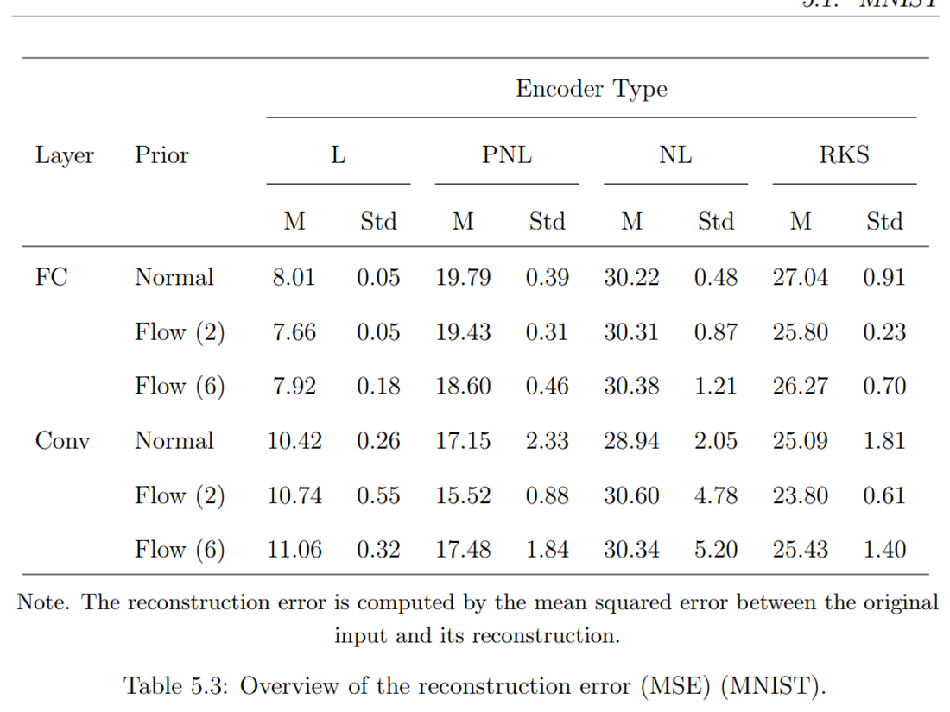

Slide 56
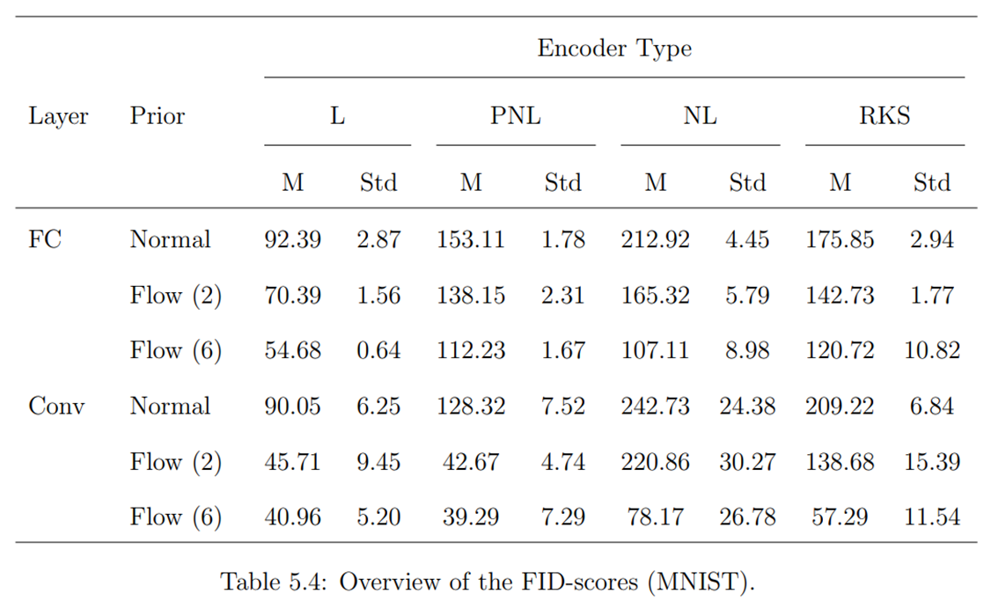

Slide 57
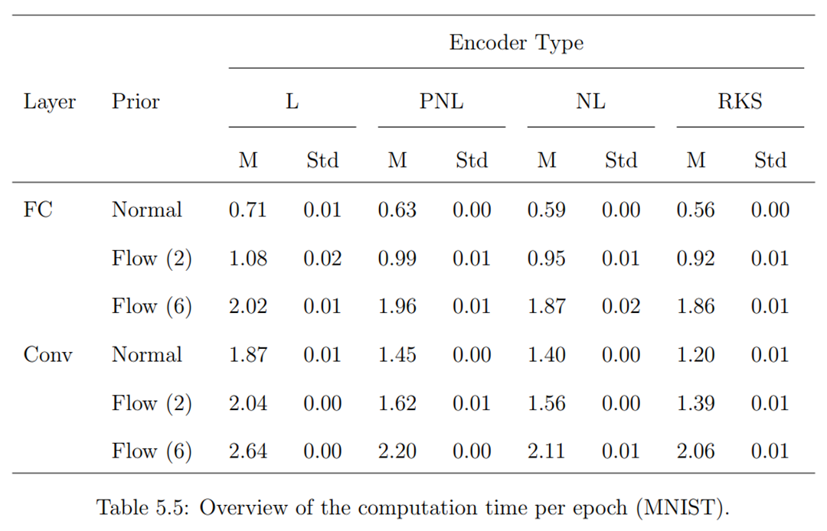

Slide 58
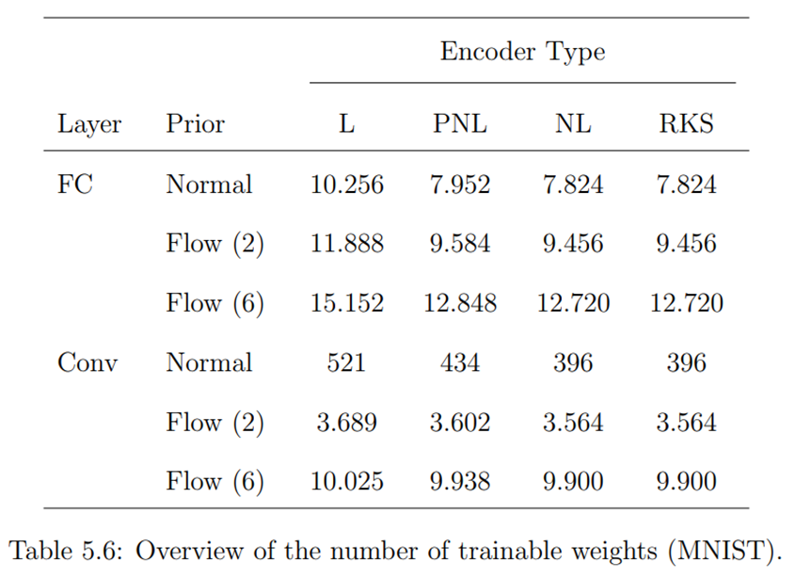

Slide 59
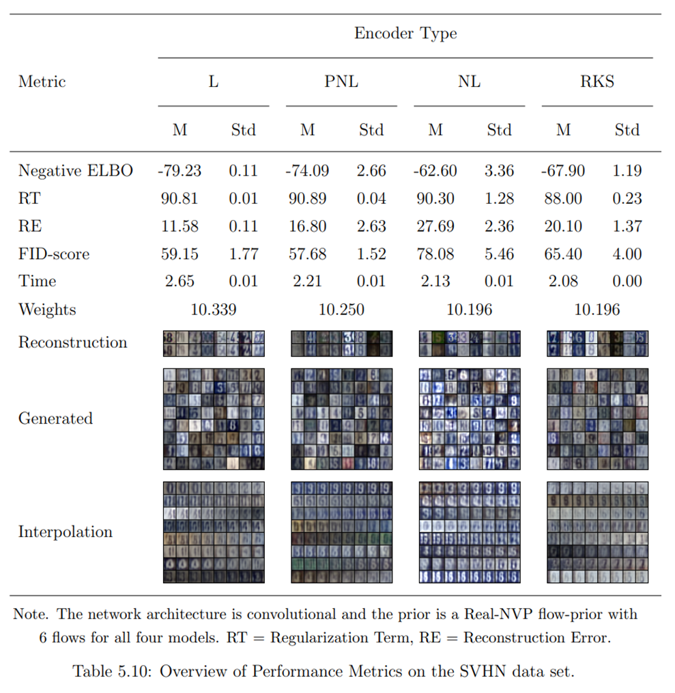

Slide 60
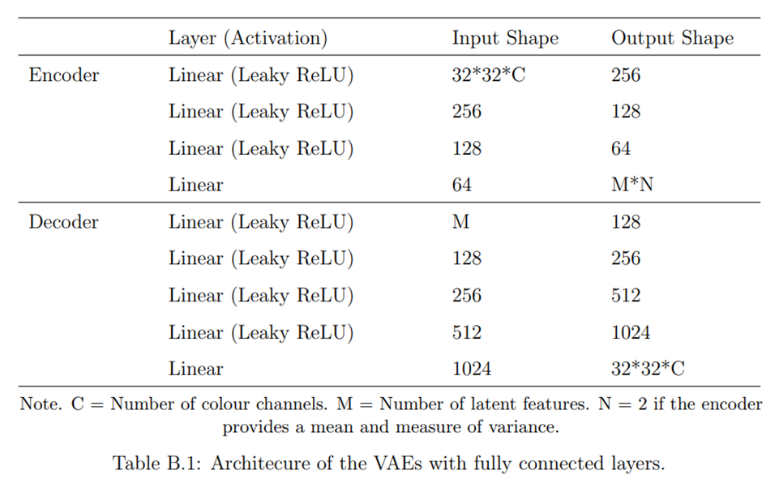

Slide 61
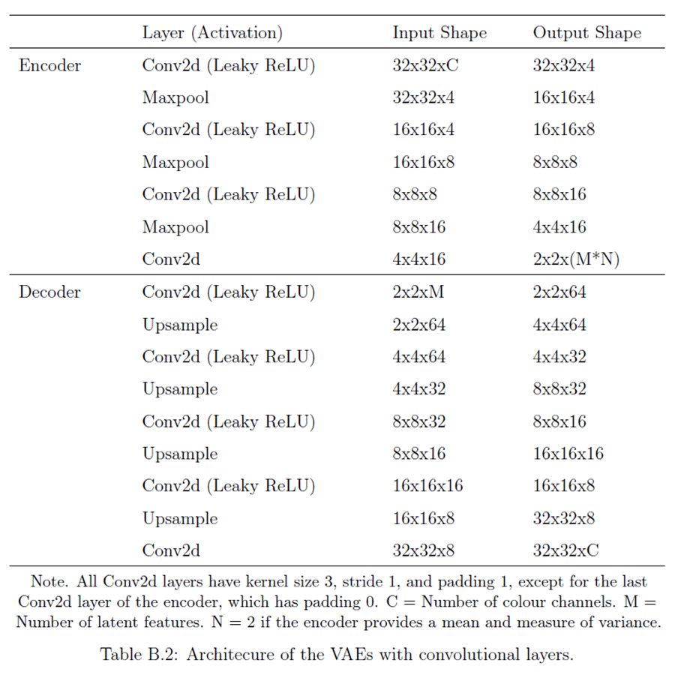

Slide 62
Scalar
||z||²₂
||θ||²₂
Vector
Input (X)
Reconstructed Input (X’)
Neural Network
Non-Learnable Neural Network
q_{φ}(z|x)
Decoder
p_{θ}(x|z)
Distribution
z
Ex-Post Density Estimation
Reconstruction Error

Slide 63
Scalar
||z||²₂
||θ||²₂
Vector
Input (X)
Reconstructed Input (X’)
Neural Network
Non-Learnable Neural Network
q_{φ}(z|x)
Decoder
p_{θ}(x|z)
Distribution
Single Layer
z
Ex-Post Density Estimation
Reconstruction Error

